Slide 1
Military Expenditure Analysis
Aluya Omofuma
DATS 6103: Data Mining

Slide 2
Overview
Conduct a mining analysis on military expenditure on 10 countries.
Nations: China, Russia, Germany, United Kingdom, France, Italy, Iran, Saudi Arabia, Israel and South Korea
Objectives:
Compare the military expenditure to each country’s GDP
Compare each nations military spending to the overall military spending of all 10 countries
Compare the military spending per capita to the GDP per capita
Single out the fastest growing countries in military spending by fixed value and percentage

Slide 3
Data Collection
On recommendation from Professor Zahadat I collected my data from worldbank.org and SIPRI.com
SIPRI.com: military expenditure per capita, military expenditure by country
Worldbank.org: country’s GDP, GDP per capita

Slide 4
Data Preprocessing
Before analysis I ensured to clean the data to fit my needs by carrying out the following steps:
loaded the countries of interest into a new data frame
cleaned the data by assigning new names for the country variables in order to maintain consistency.
assigned the country names as the index using the “set_index” function
made it easy to convert the values to datatype –float.

Slide 5
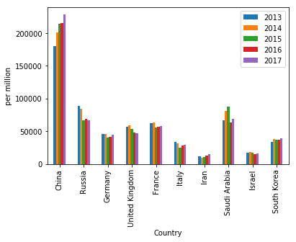
Display each country’s military expenditure over the last 5 years.
We notice that China spend the most and Iran spends the least on their military
I attribute China’s increasing spending to the boom in their economy and they are simply fortifying themselves as a global superpower

Slide 6
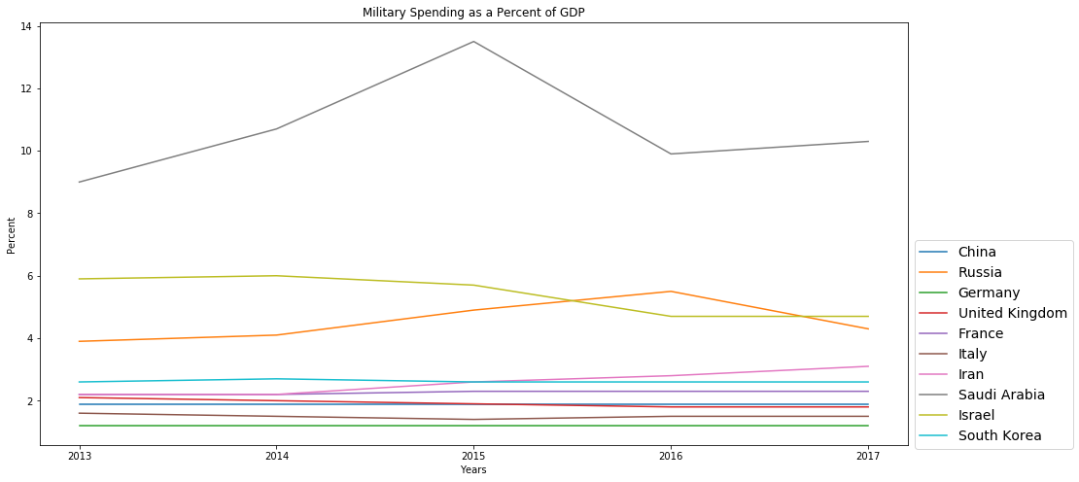
Compare Military Spending as a percentage of GDP

Slide 7
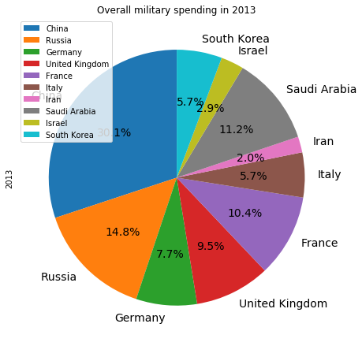
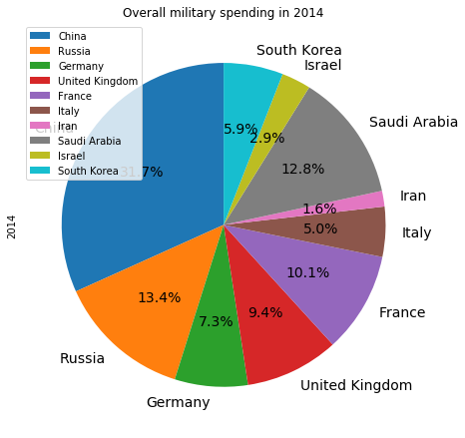
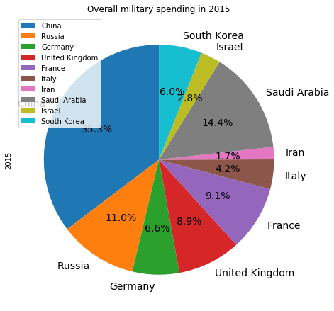
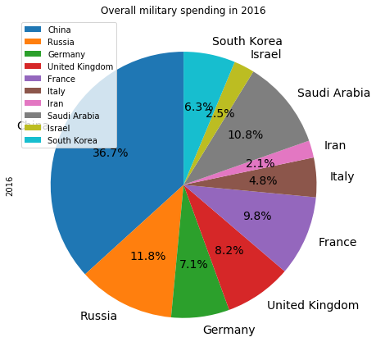
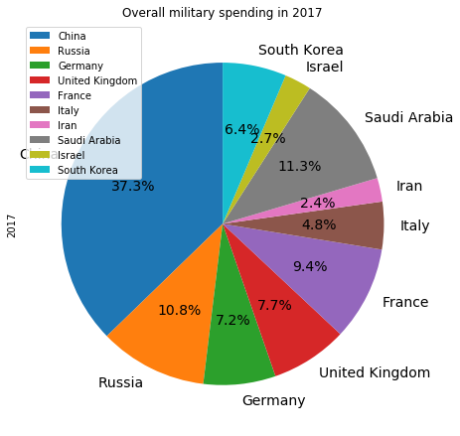
Compare the spending of each nation to the total spending of all countries
China and Russia alone make about 45% of the total spending on military

Slide 8
Compare the military spending per capita to the GDP per capita
The military spending per capita is about 5% of each country’s GDP per capita.
We infer that each person produces about 5% of the country’s spending on military

Slide 9
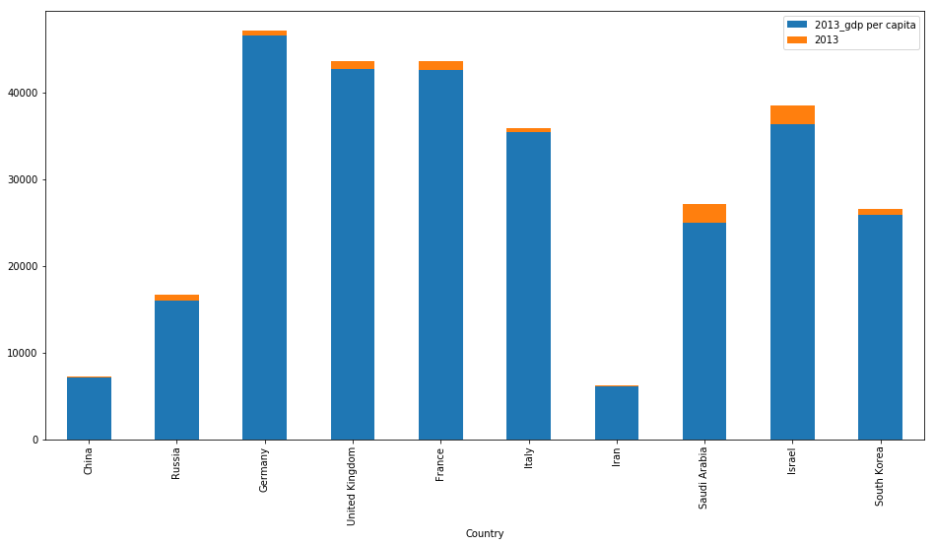
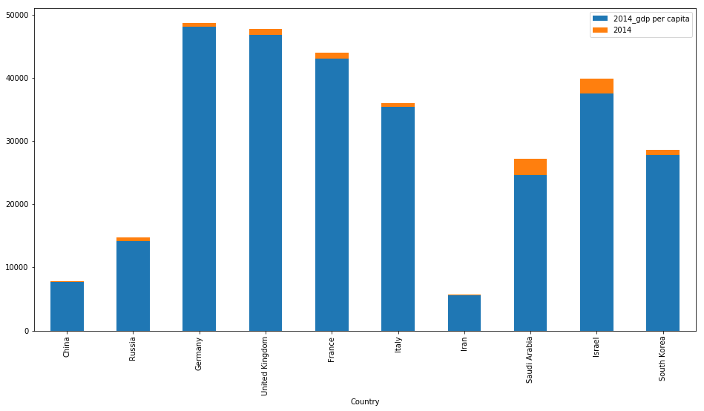
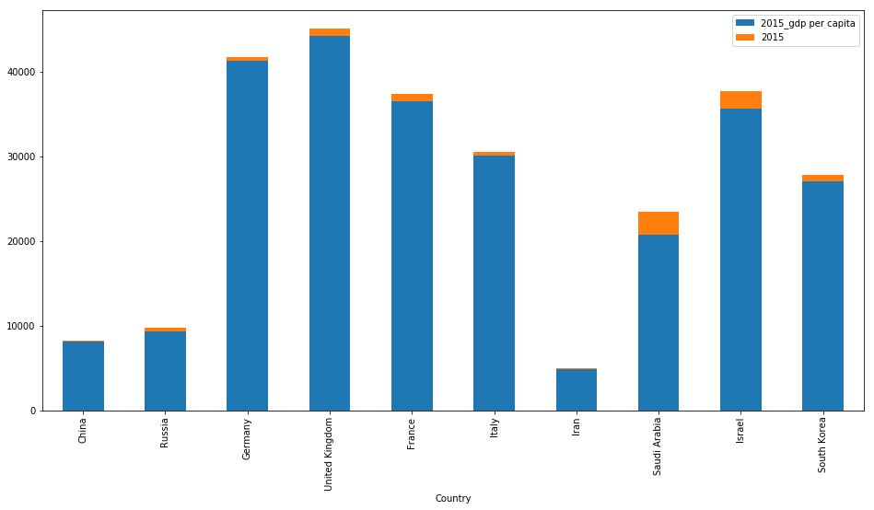
GDP per capita vs Military spending per capita

Slide 10
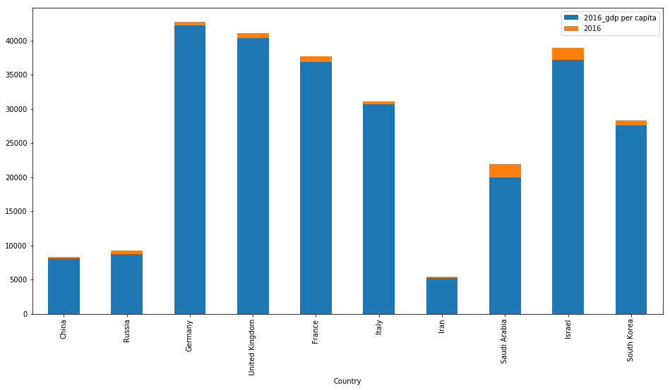
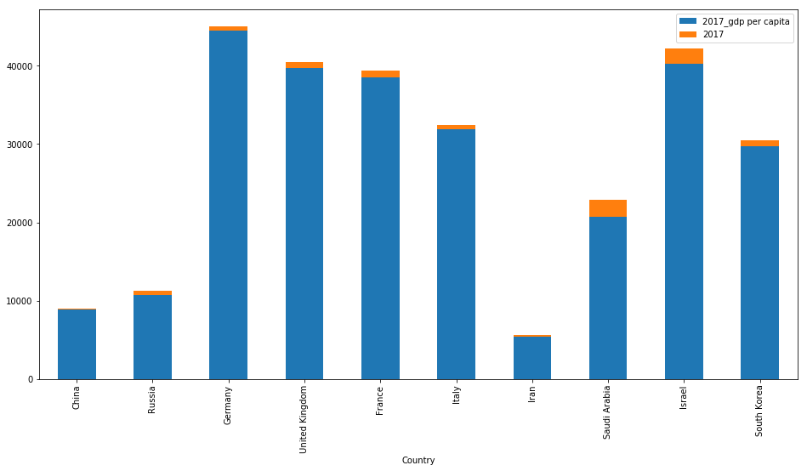
GDP per capita vs Military spending per capita

Slide 11
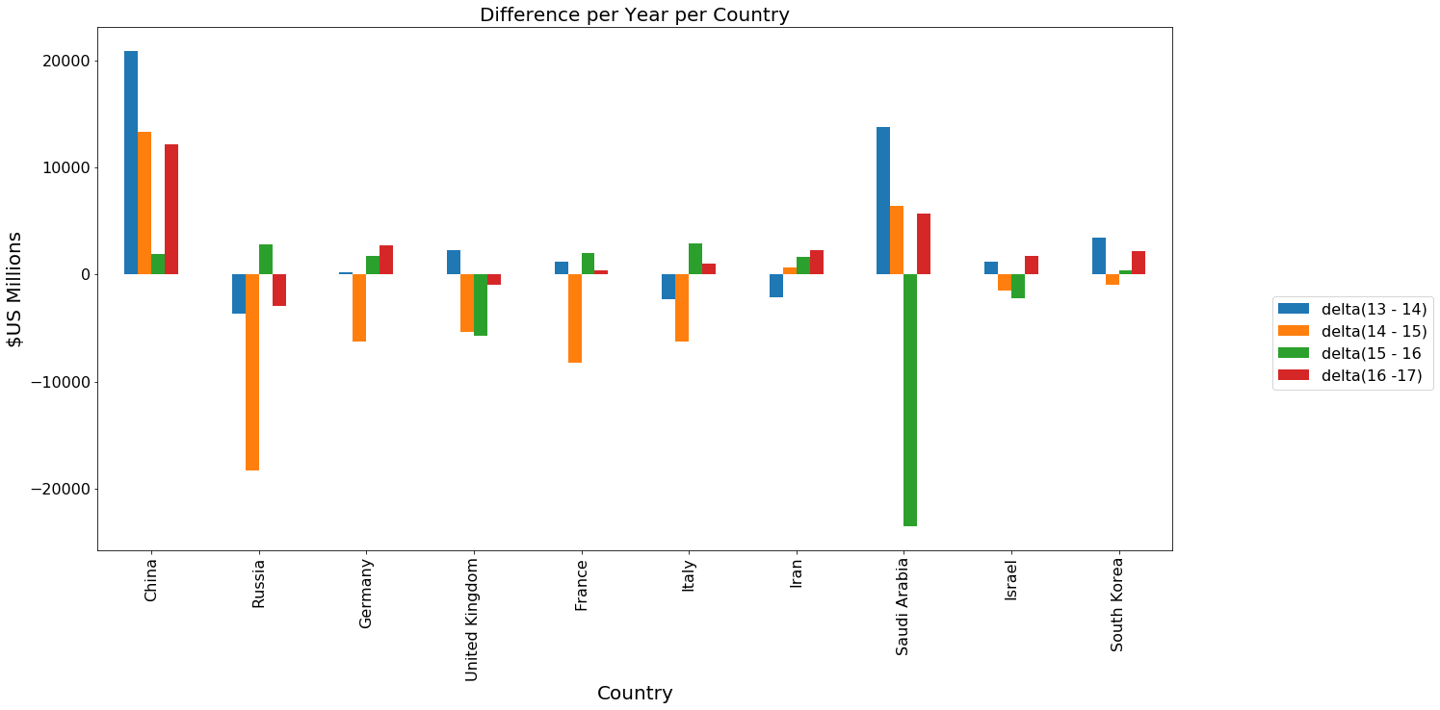
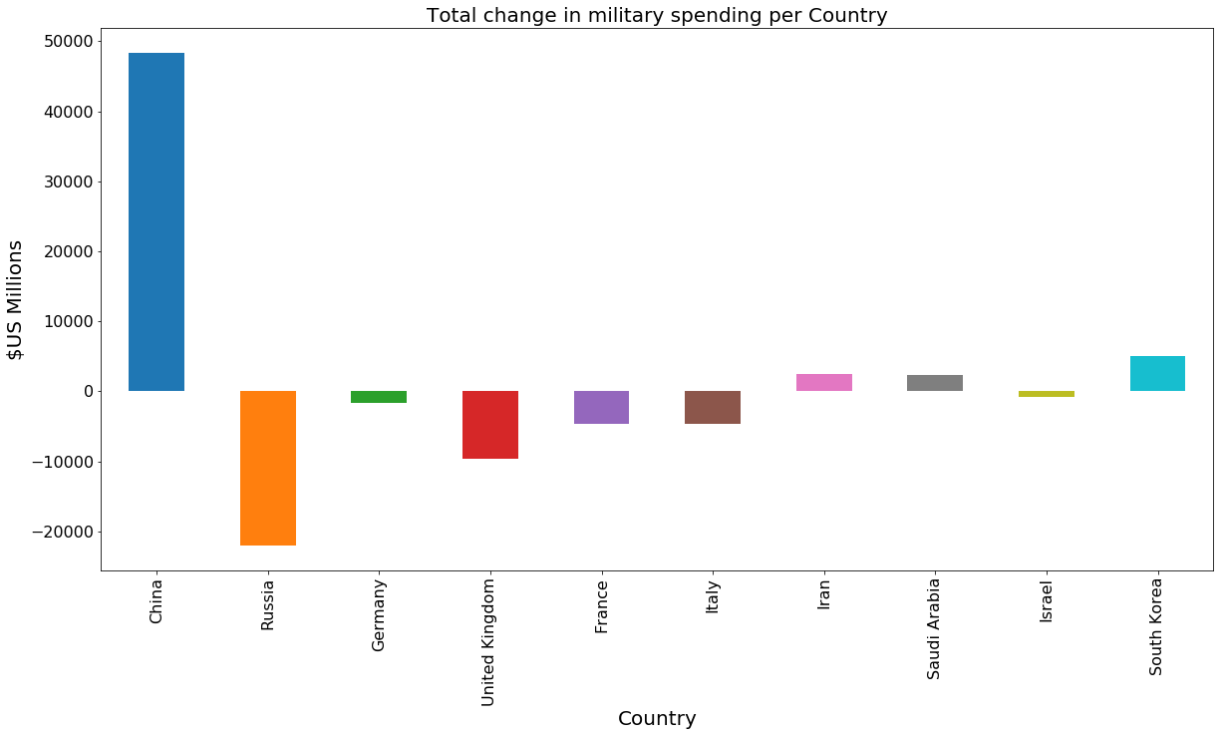
Single out the fastest growing countries in spending.
Below is a fixed value representation

Slide 12
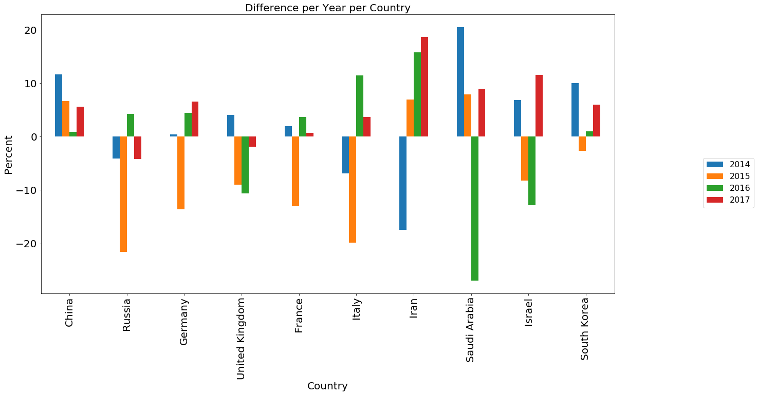
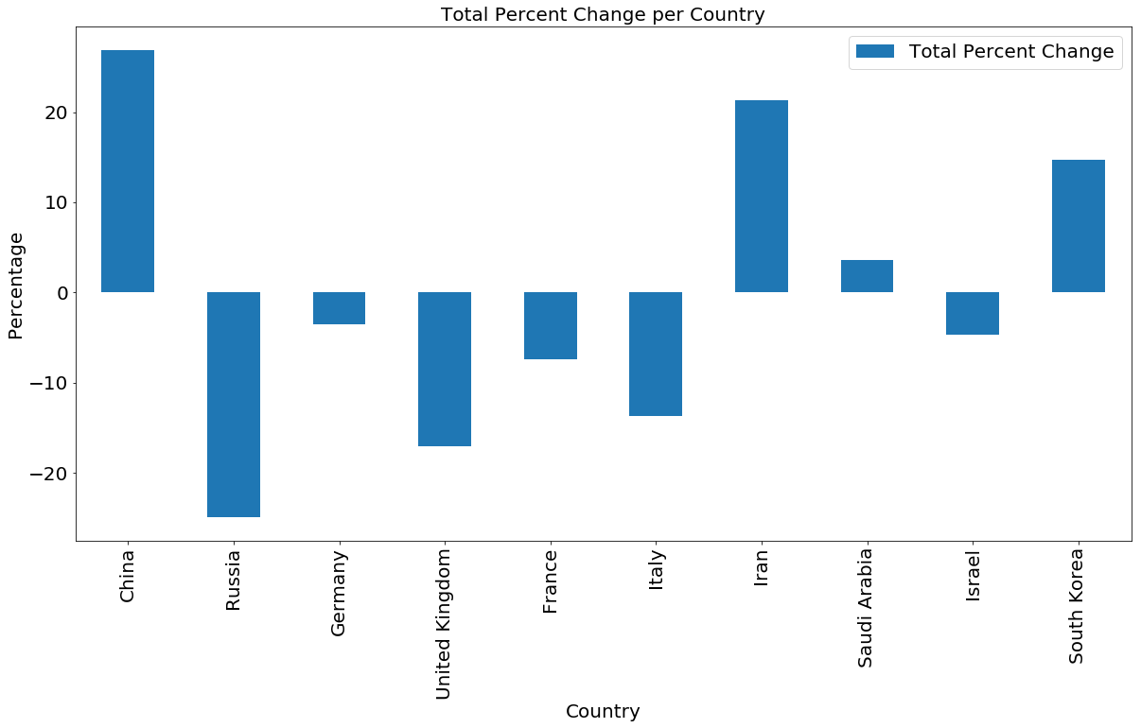
Percentage change in military spending

Slide 13
Learning Outcomes
Learned the fundamentals of cleaning data in Pandas
Data preprocessing
Dropping and appending columns as needed
Performed aggregates on various variables
Learned how to make descriptive data visualizations using matplotlib
In addition to the technical skills I also gained an appreciation for current affairs by studying military involvement in countries that were analyzed

Slide 14
Conclusion
Summary
China is continuing its growth as a major global player by consolidating the strength of their military. They spend the most on their military.
China and Russia are two of the largest nations in the world. In land mass and population and their military budgets account for about 45% of the total military spending of the countries analyzed.
Saudi Arabia and Israel have the highest military spending per capita compared to GDP per capita. This can be explained by high tensions across the borders of both countries
China has the highest growing military budget among all 10 nations which we attribute to their ever-strengthening economy.

Slide 15
Conclusion
Predictions
I anticipate that as China’s economy continues to grow they will keep spending to consolidate themselves as the eastern superpower the USA is to the West.
Saudi Arabia has an ongoing conflict with Yemen and we can expect them to continue investment in military protection for its citizens which indicates that the military spending per capita will continue to be relatively high.
I anticipate that the major European countries like France, Germany, Italy and the UK will continue to maintain a modest military budget except there is a major international conflict.

